Slide 1

The Future of Music
Andrew Birnbaum

Slide 2
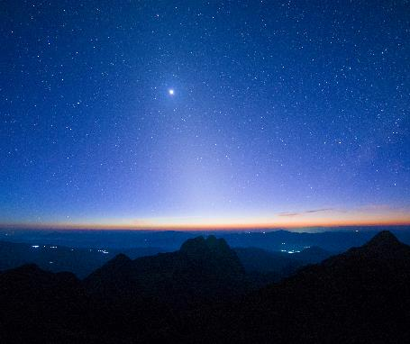
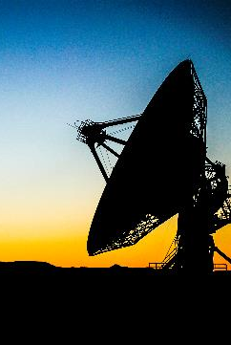
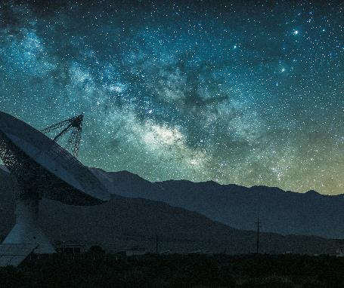
Why is music important?
Humans have greatly associated themselves with Songs & Music
Music can improve mood, decrease pain and anxiety, and facilitate opportunities for emotional expression
Research suggests that music can benefit our physical and mental health in numerous ways

Slide 3
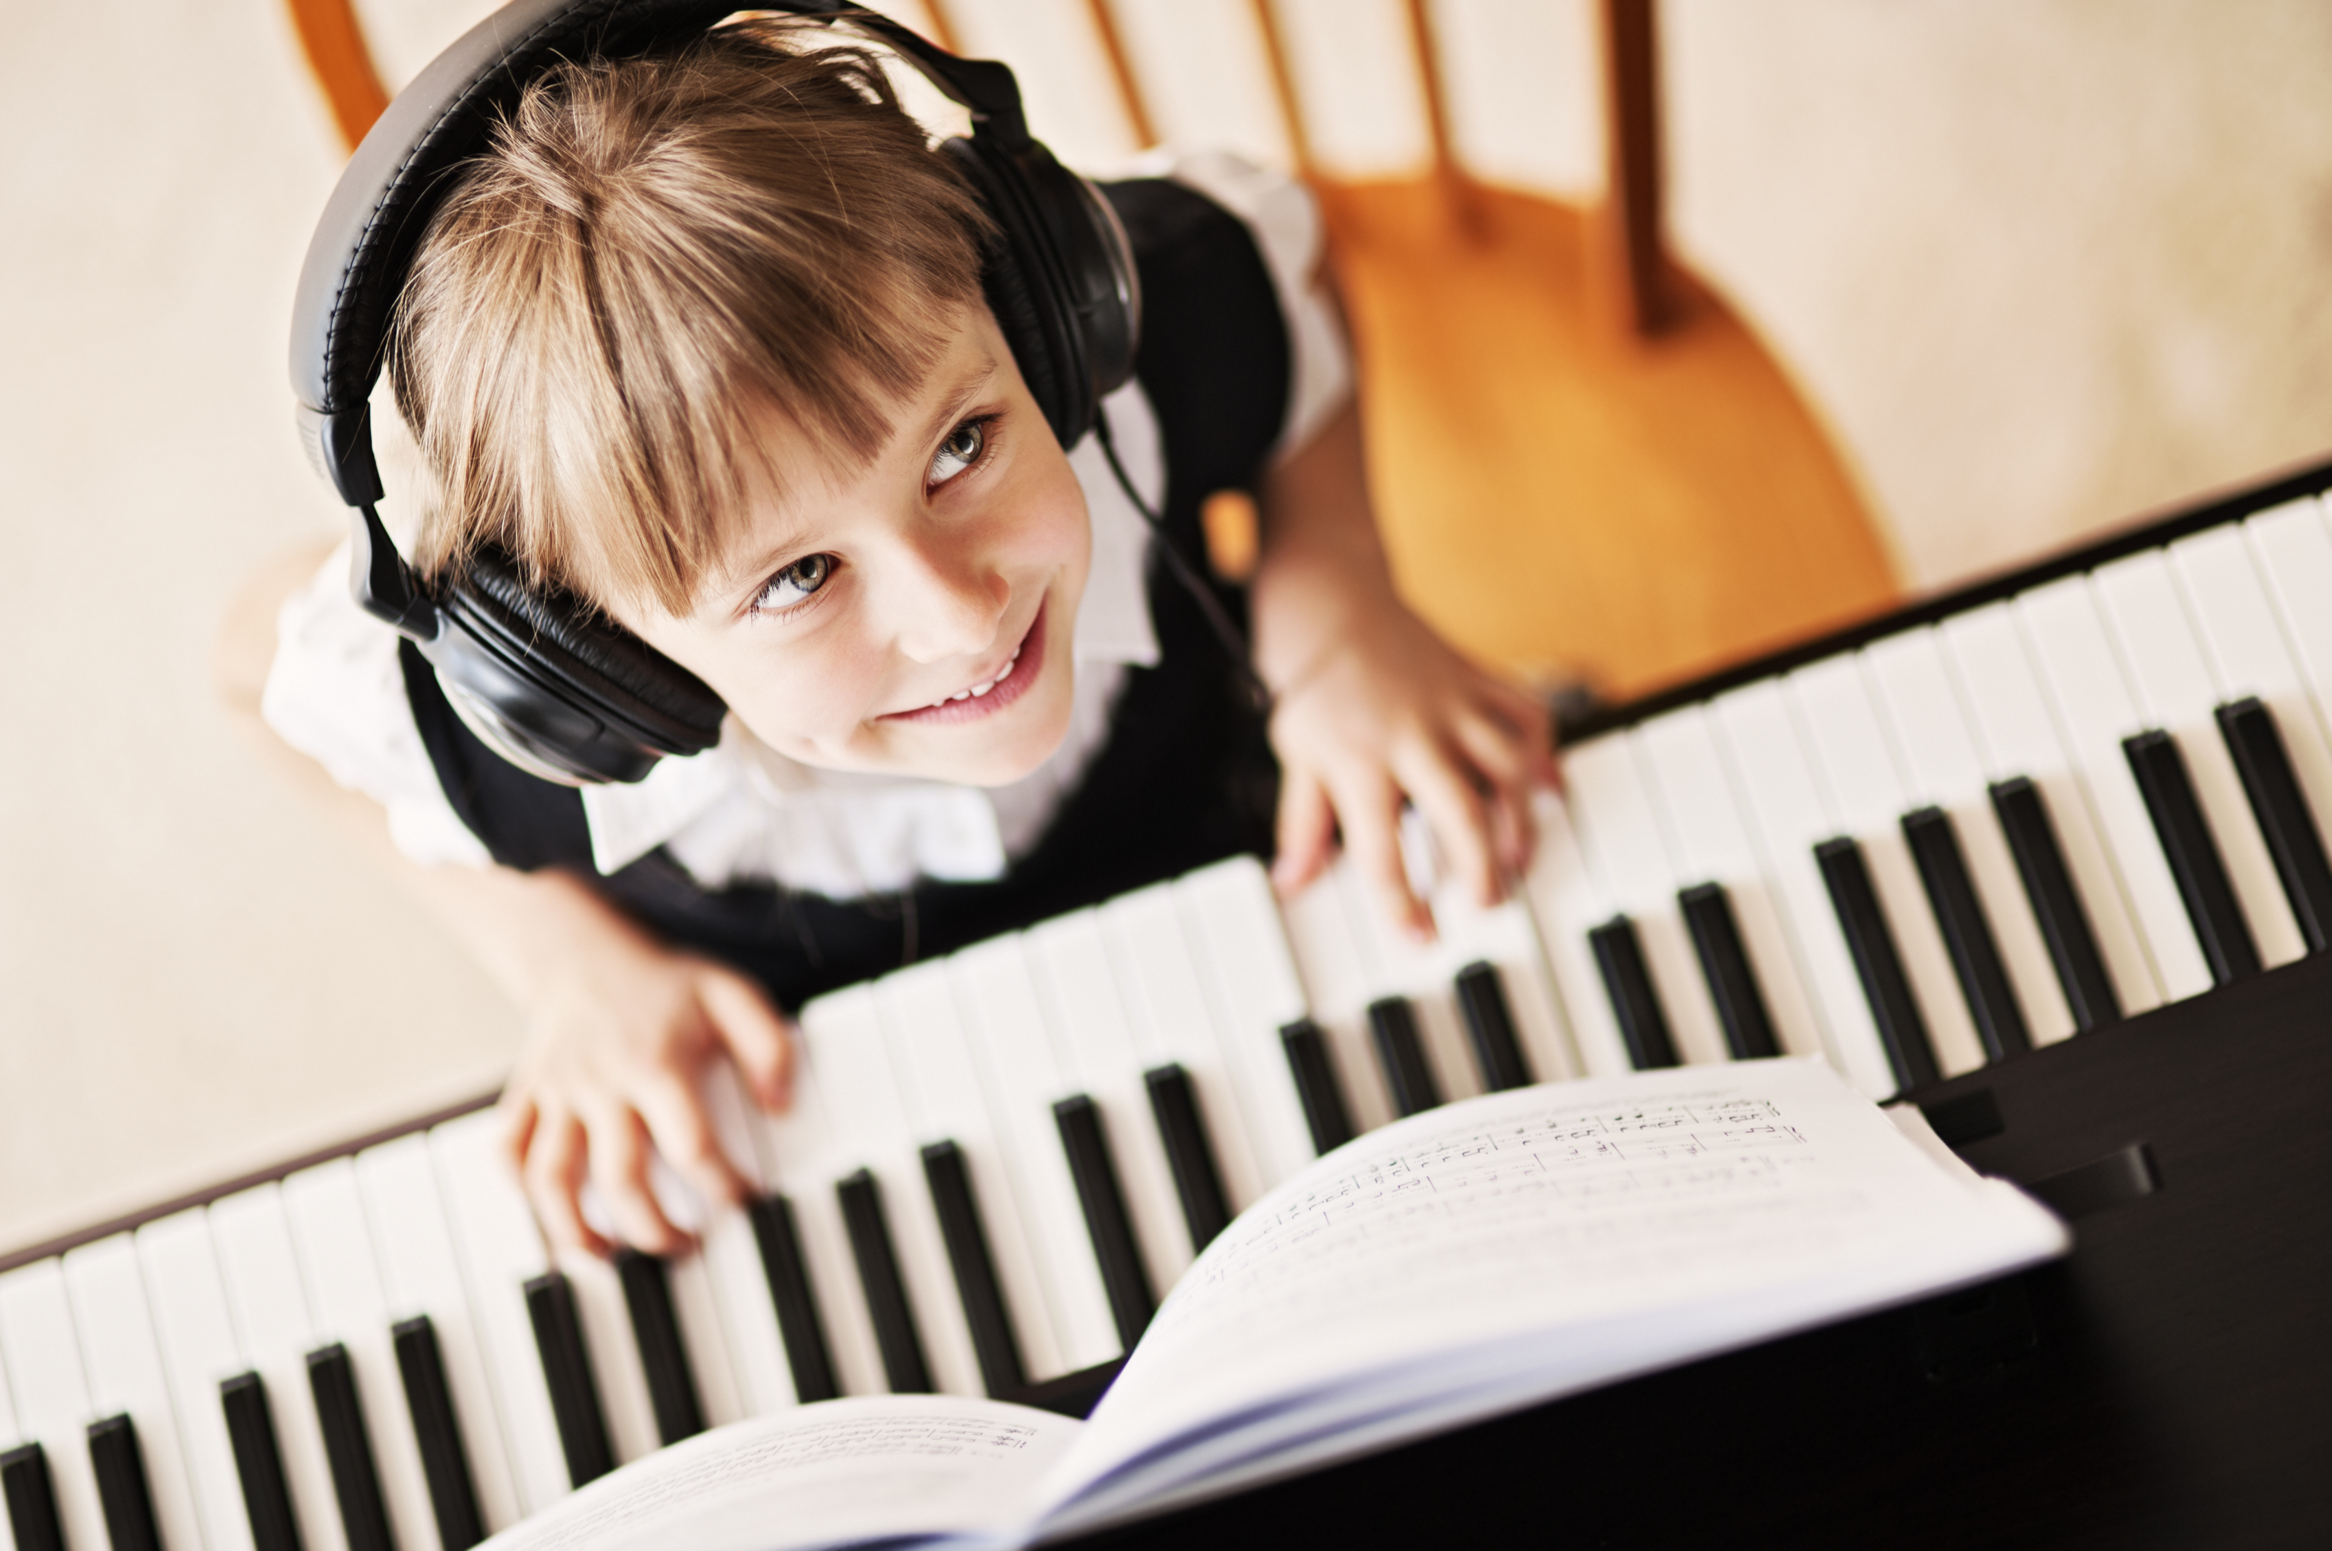
Personal Connection
Music is an emotional escape from reality which is Especially important While Living thRough a pandemic
I literally listen to music for 5 hours a day Just to Cope With Reality
Listening to Popular music can elevate mood popularity indicates enjoyment en masse

Slide 4

Project Goal
Studies Have Been Carried Out To Understand Songs & Its Popularity Based On Specific Features
Over 14,000 Song Samples Were Broken Down To Create Features For This Set
The Project Goal is to Predict Song Popularity

Slide 5

Features to Predict Music Popularity
Song Duration
Acousticness
Danceability
Energy
Instrumentalness
Key
Liveness
Time Signature
Audio Valence
Loudness
Audio Mode
Speechiness
Tempo
https://www.kaggle.com/datasets/yasserh/song-popularity-dataset

Slide 6



Let’s get Down to Business!
Tiesto

Slide 7
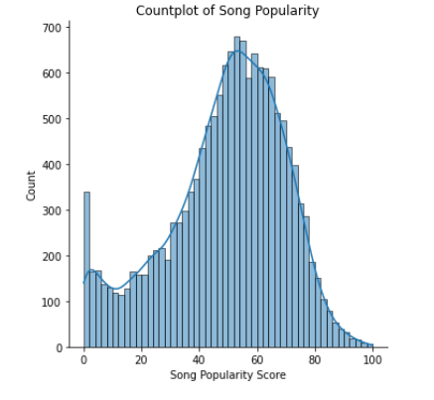
1. Most of the Songs Are in the 40-60 Range 2. There are few Songs at the top 80-100 Range 3. There are also a lot of Songs that are zero
Song Popularity Distribution

Slide 8
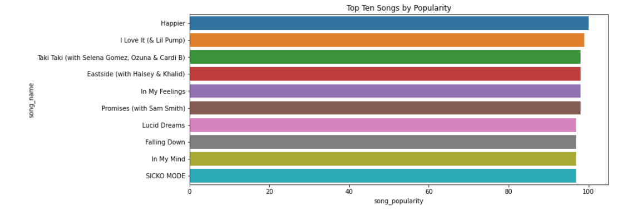
Top 10 Most Popular Songs
Spotify Streams
1.65 Billion
590 Million
1.28 Billion
1.3 Billion
1.22 Billion
868 Million
1.95 Billion
837 Million
1.1 Billion
1.6 Billion

Slide 9
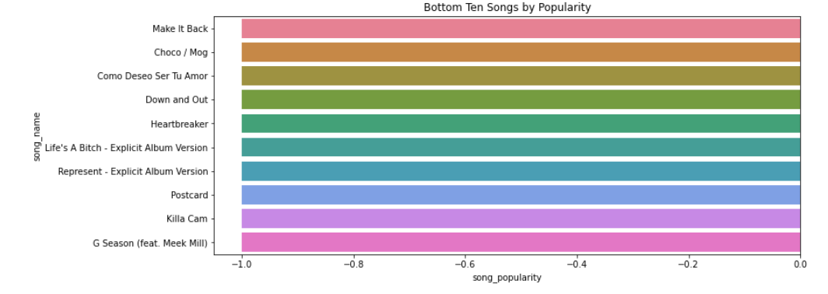
Bottom 10 Songs by Popularity
Spotify Streams
2.5 Million
1.49 Million
1. 5 Million
17.8 Million
3.6 Million
10.4 Million
953 Thousand
6.2 Million
4.85 Million
5.87 Million

Slide 10


Cleaning The Data
The First Step was to Remove NA Values and Duplicate Songs
Next was to Check if the Features Were Correlated/Similar and Eliminate Extraneous Columns
Explore Visualizations To See if Features are Actually Helpful in Predicting Results

Slide 11
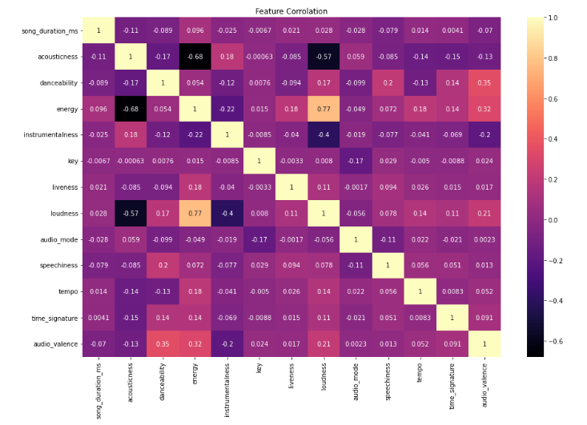
Heat Map Of Features
Energy & Loudness have a 0.77 Correlation
Energy & Acousticness have a -0.68 Correlation
Loudness & Acousticness have a -0.57 Correlation

Slide 12
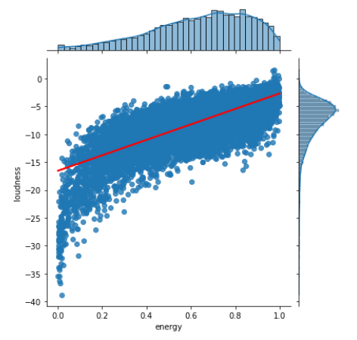
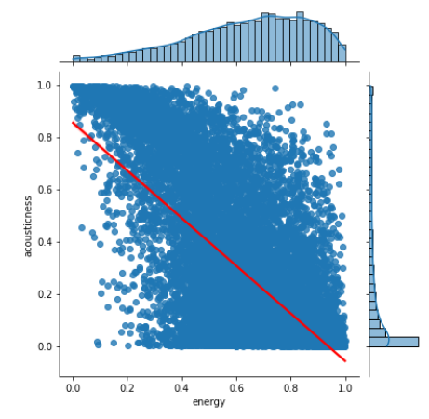
Energy was too heavily Correlated and was Removed
Loudness vs Energy
Acousticness vs Energy

Slide 13
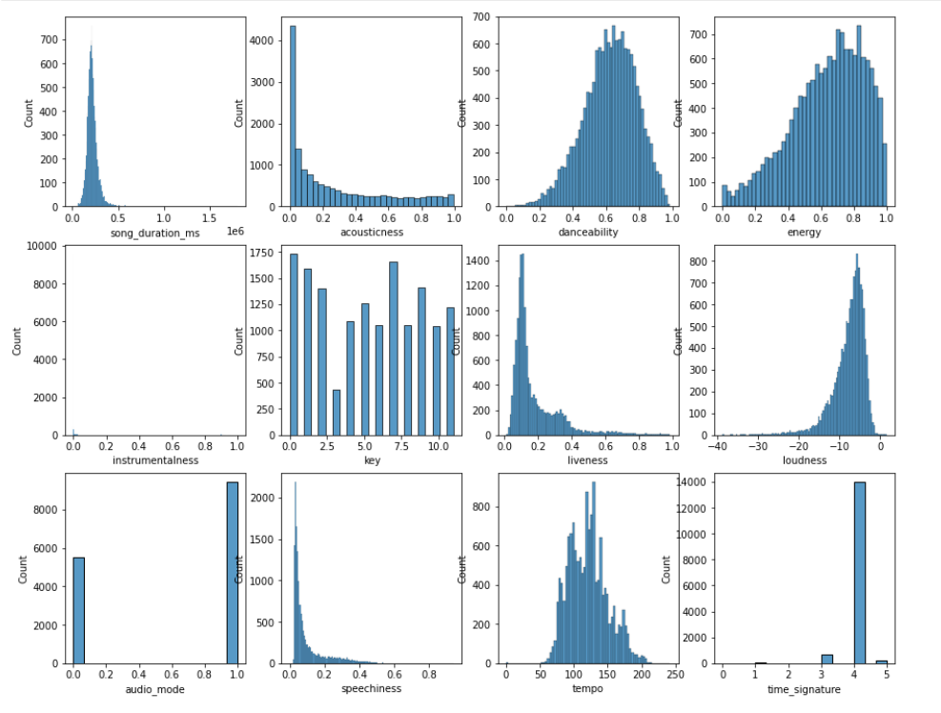

Countplots of all the Features to Further Investigate…
What is going on with Instrumentalness?

Slide 14
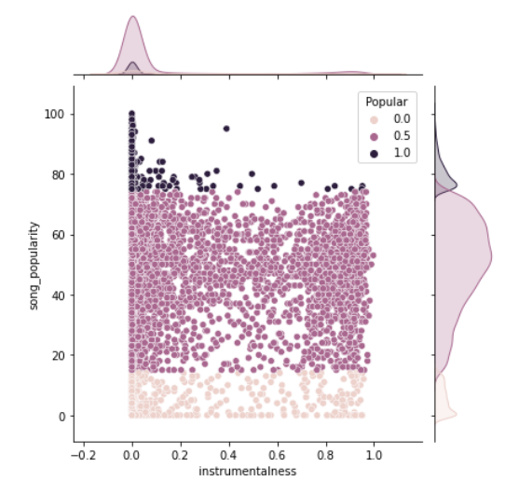
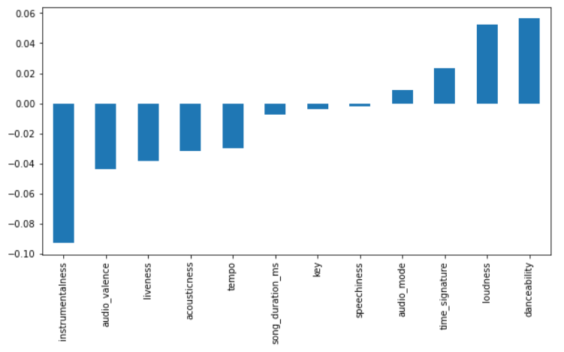
Instrumentalness has High Negative Correlation with Song Popularity
Song Popularity vs Instrumentalness
Feature Correlation with Song Popularity

Slide 15

Let’s get Down to Business Part 2!
Tiesto

Slide 16

Splitting the Data
X=Features, Y=Song Popularity (1-100)
Multi-Class Classification
Song Data was Split 70/30
Data was Scaled using MinMaxScaler

Slide 17

Time to Test the Data
Test 1: Logistic Classifier
Test 2: Decision Tree Classifier
Test 3: Random Forest Classifier
Test 4: K Nearest Neighbor (K=5) Classifier
Test 5: K Nearest Neighbor (K=32) Classifier
Test 6: Support Vector Machine Classifier
Test 7: Keras Classifier (Deep Learning)

Slide 18

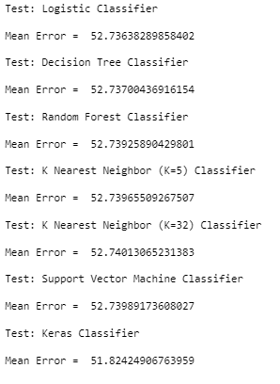
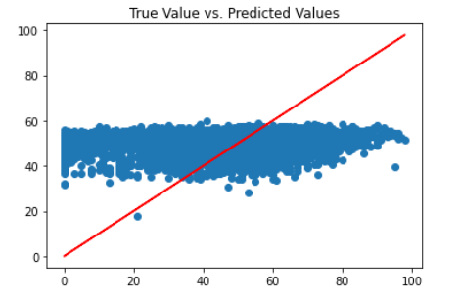

First (Attempt) Failure
Machine
Mean Error For 7 Classifiers > 50!
It looks like it guessed about 50 every time

Slide 19
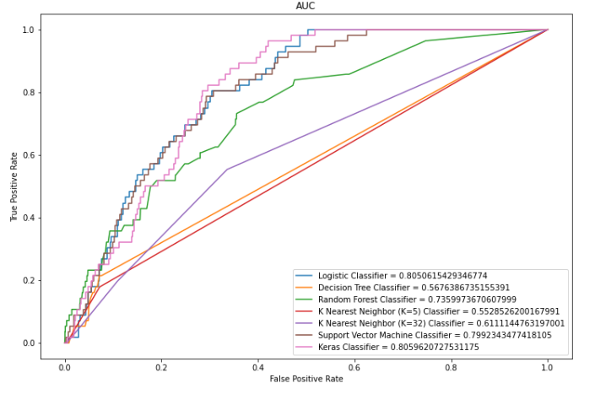
Results of Binary Class
Using Binary Classification Instead Of Multi-Class Gave Much Better Results
Area Under ROC Curve Results Look Very Promising
80.5% For Both Logistic And Keras Classifiers & 80% For SVM

Slide 20
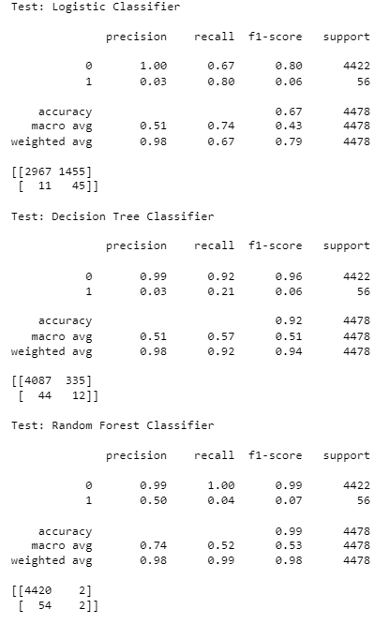
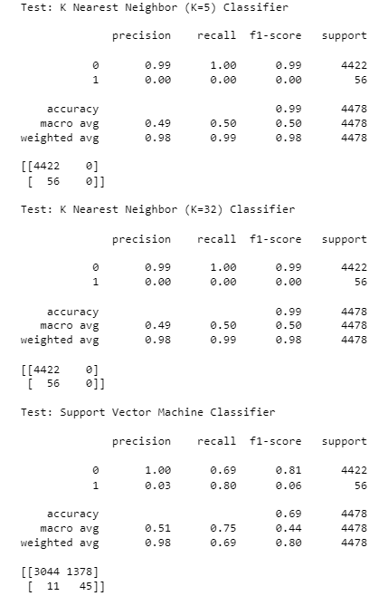
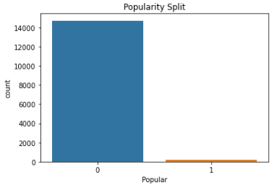
The Truth About Data
The Tests Were Just Guessing Not-Popular Every Time! Accuracy Depends On Sample Size Being Equal!
Classification Report & Confusion Matrix
Not Popular=14724, Popular=202
Largely Skewed Data
85% and up = Popular
84% and down= Not Popular

Slide 21
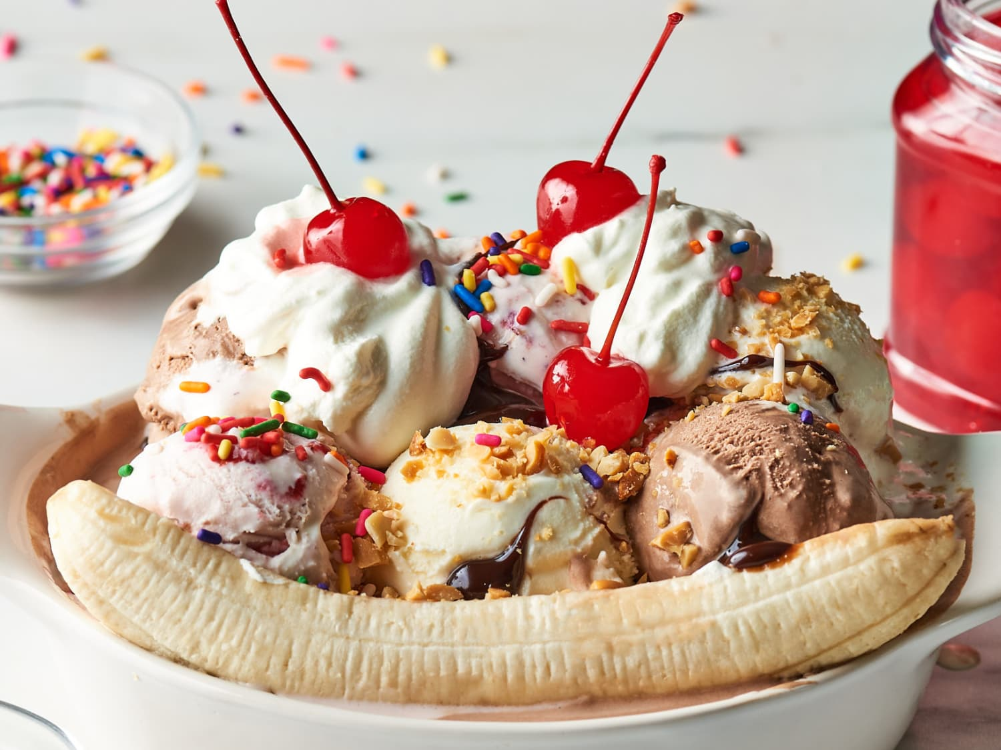
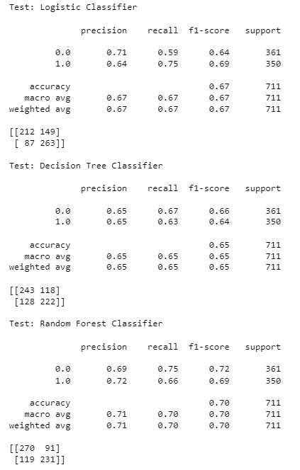
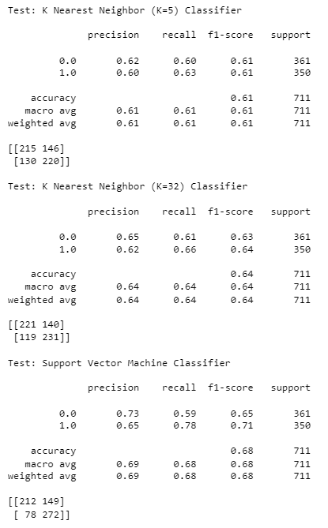
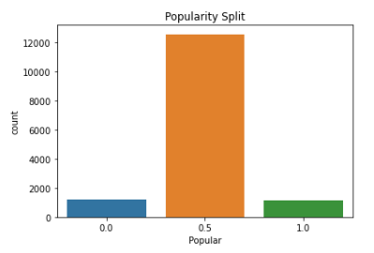
Proper Split=Proper Results
Classification Report & Confusion Matrix
Not Popular=1,226 Popular=1,141
More Evenly Split
75% and up = Popular
15% and down = Not Popular
Average=12,559 (Save For Later)

Slide 22
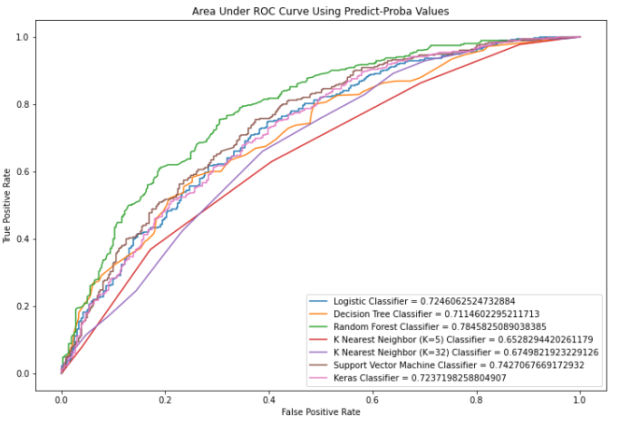
Results of Unbiased Data Set
Properly Split Data Gives the Most Accurate Predictions and Avoids Bias
Values for Curve are Prediction Percentages Probability not 1s and 0s
78.5% For Random Forest Classifier
74.3% For SVM and 72.4% Keras

Slide 23
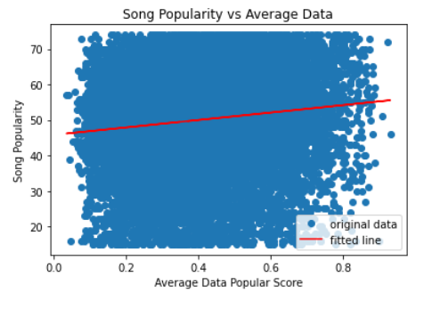
Testing Average Songs
Average=12,559 songs
Songs were processed the same was as Train/Test set (scaling)
Tested using the Best Model (RFC) to predict probability of popularity
Not if popular or not
Slope=10.49
Pvalue=4.7 x10^-44 therefore the correlation is significant

Slide 24

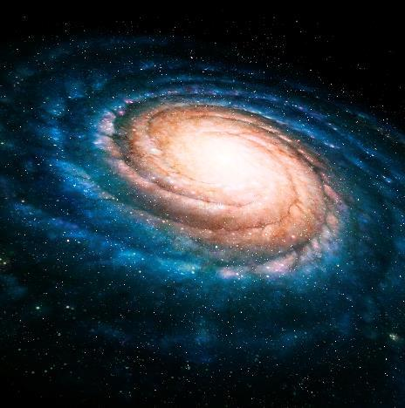

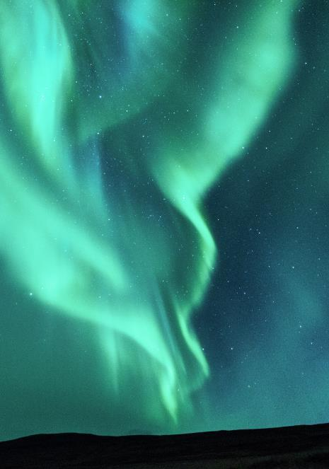
Conclusions
Model predicts an impressive 78.5% accuracy compared to the under 50% for guessing (data isn’t exactly even)
We can predict if a song is going to be Hit or a Flop without even hearing the song, Just by using the features of the songs. This power is truly incredible as the fate of music is at stake.
Another important point is that it can predict with fine accuracy if a song will be an upper or lower, average song.

Slide 25
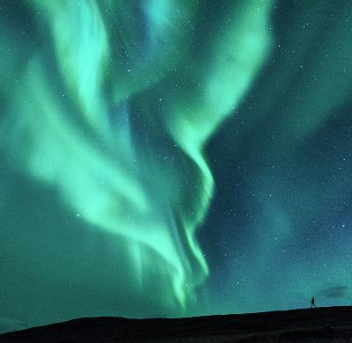



Applications
Creating Albums: It is a law that every album in History must have 2 certified BANGERZ! And 8 mediocre songs. This model can help plan the whole album, from the very popular to the mediocre songs.
Creating Music: Artists can make music by using features that indicate popularity They can costume tailor their songs to have Popular Features

Slide 26
Problems
When the model is wrong, 21.5% inaccurate rate, the song will be an absolute train wreck.
The question was Too Simple: Is this song really popular or un-popular? Most people can distinguish that by listening for 5 seconds.

Slide 27
Solutions
It would be smart to listen to the song first don’t completely rely on the model
Predict multi-class data using one-hot encoding with the keras model to predict actual popularity values, which is more valuable information
The hard question: would be to predict between average and very popular to see accuracy between similar ratings

Slide 28
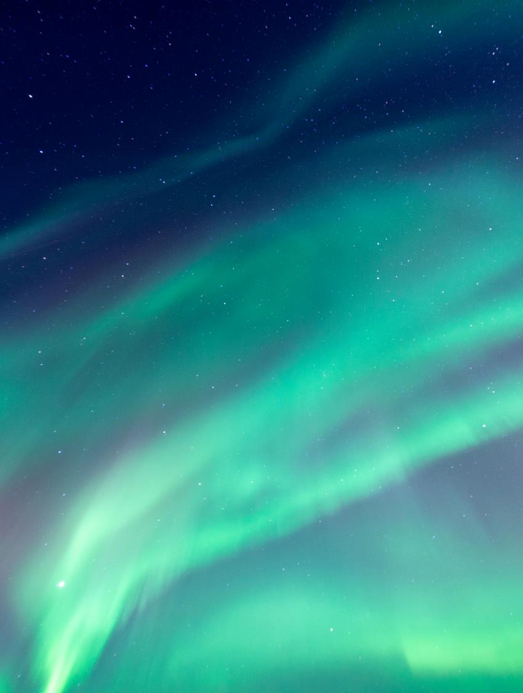

Thank You
Any Questions?
This is my nephew, and he approves this message!

